Slide 1

Paper ID: 301
Deep Learning Based Real Time Bengali Multi-Vehicle Number Plate Detection
MD. RUHUL AMIN SHAZID
Bangladesh University of Business and Technology, Bangladesh
MD. HASIBUL ISLAM
Bangladesh University of Business and Technology, Bangladesh
SHANEEN ARA
Bangladesh University of Business and Technology, Bangladesh
MD SOHANUR RAHMAN
National University, Bangladesh
Presented By, Shaneen Ara

Slide 2

Outline
Abstract
Introduction
Related Works
Methodology
Result Analysis
Evaluation
Conclusion
References

Slide 3
Abstract
The study develops an advanced system using YOLOv8 to accurately and quickly detect Bengali vehicle license plates in real-time, outperforming traditional CNN models.
Leveraging tools like Google Collaboratory Pro, the YOLOv8 model ensures efficient, fast, and accurate real-time detection.
The system aims to reduce traffic congestion and revenue leakage, contributing to smarter, more sustainable transportation through deep learning techniques.

Slide 4
Introduction
Real-Time Bengali License Plate Detection: The study uses advanced deep learning techniques to develop a system that accurately detects vehicle license plates in real time, specifically for the Bengali language and diverse environments.
YOLOv8 for Speed and Accuracy: YOLOv8, an advanced deep learning model, is employed for its faster, more accurate, and easier-to-use features compared to traditional CNN models.
Use of Modern Tools: Tools like Google Collaboratory Pro and Google Compute Engine are used to ensure real-time functionality and high accuracy in license plate detection.
Addressing Real-World Challenges: The research aims to solve issues like traffic congestion and revenue leakage through precise license plate detection, contributing to smoother and more efficient transportation infrastructure.

Slide 5
Related Works
Author | Name | Dataset | Approach | Research Gap | Result
Vaiyapuri et al \cite{n9} | SSA-CNN Model | Multiple datasets | Deep Learning-based VLPR with SSA-CNN | Challenges due to varying angles, shapes, and lighting | Achieved an accuracy of 98.3% (0.983)
S. Shen et al \cite{a2} | Enhanced Yolov3 for Real-Time License Plate Detection | Custom car plate database (6668 images) | K-Means algorithm for anchor box optimization | Lack of sufficient car plate datasets | Improved accuracy over original Yolov3
D. Baviskar et al \cite{h2} | YOLOv5 and OCR-based ANPR System | Image set (4165 images) | YOLOv5 and easyOCR for plate recognition | Real-time applications and adaptability to other formats | Achieved high precision of 99.6% (0.996)
Table 2: Some Related Works Sample

Slide 6
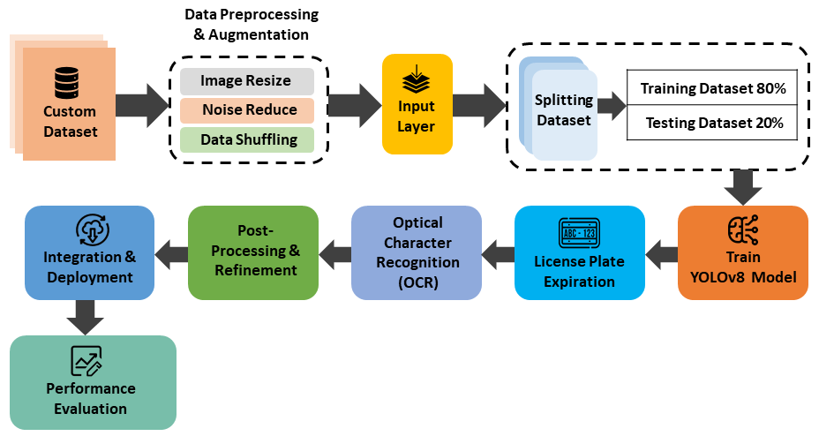
Methodology
Figure 1: Methodology Architecture

Slide 7
Methodology
Proposed Model Architecture: The system is based on the YOLOv8 architecture, which processes vehicle images, localizes license plates, and recognizes characters using Optical Character Recognition (OCR)​.
Data Gathering: A diverse set of vehicle images is collected, annotated with bounding boxes around license plates, and split into training, validation, and test datasets​.
Data Analysis and Preprocessing: Images are preprocessed by resizing, noise reduction, and shuffling. The dataset is formatted for YOLOv8 to enable accurate model training without needing fixed image dimensions.​
Training and Validation: YOLOv8 is trained using annotated images, with iterative learning processes for improving detection accuracy. The model is regularly validated to fine-tune parameters.
Testing and Evaluation: The trained model is tested on unseen images to evaluate performance. Key metrics like precision, recall, F1-score, and accuracy are used to assess the model​

Slide 8
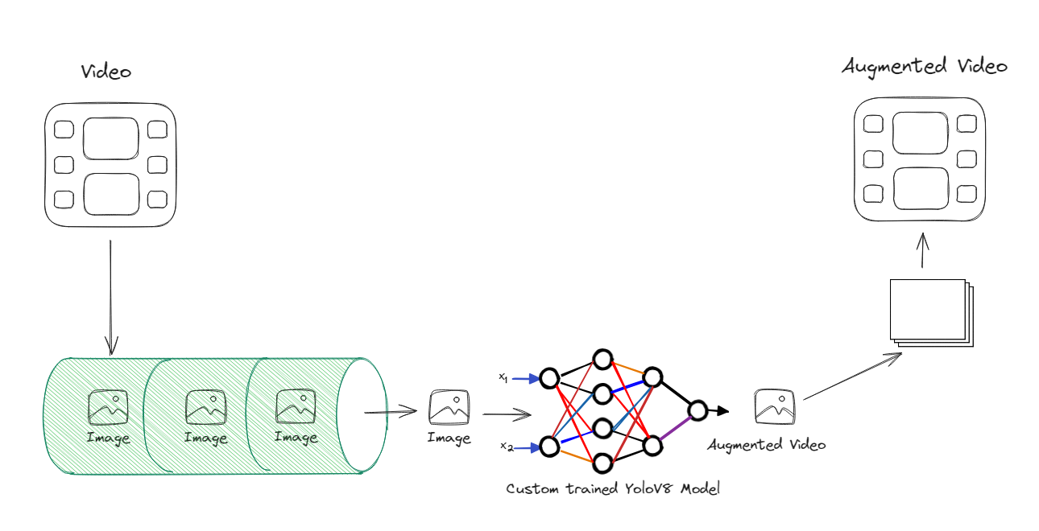
Result Analysis
Figure 2: Random Training Video Data

Slide 9
Evaluation
Hyperparameters of Models | Value
epochs | 50
patience | 50
batch | 16
workers | 8
learning rate | 0.01
scale | 0.5
max detection | 300
warmup bias learning rate | 0.1
Table 2: Hyperparameters used for this work

Slide 10
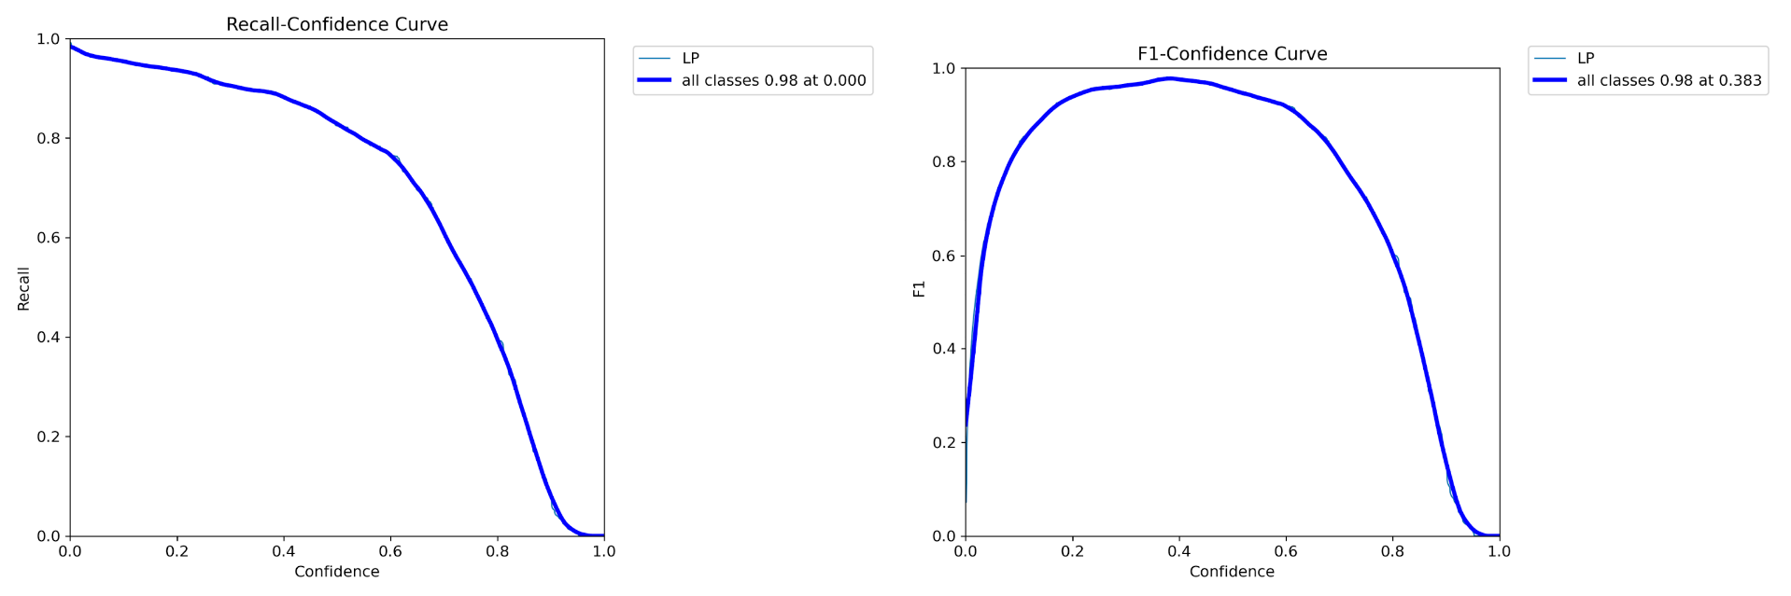
Evaluation
Figure 3: Recall the confidence curve and F1-Confidence Curve

Slide 11
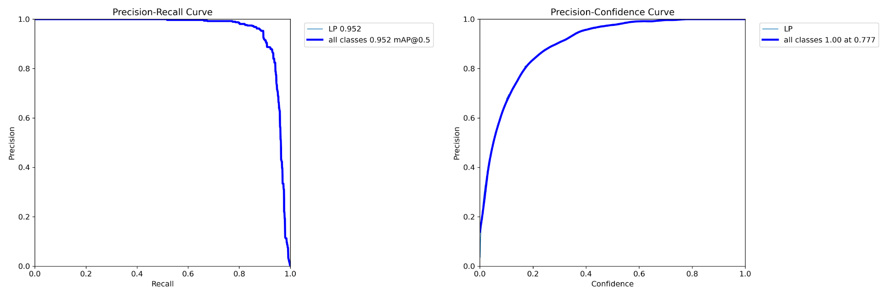
Evaluation
Figure 4: illustrates precision and recall and Precision confidence curve

Slide 12
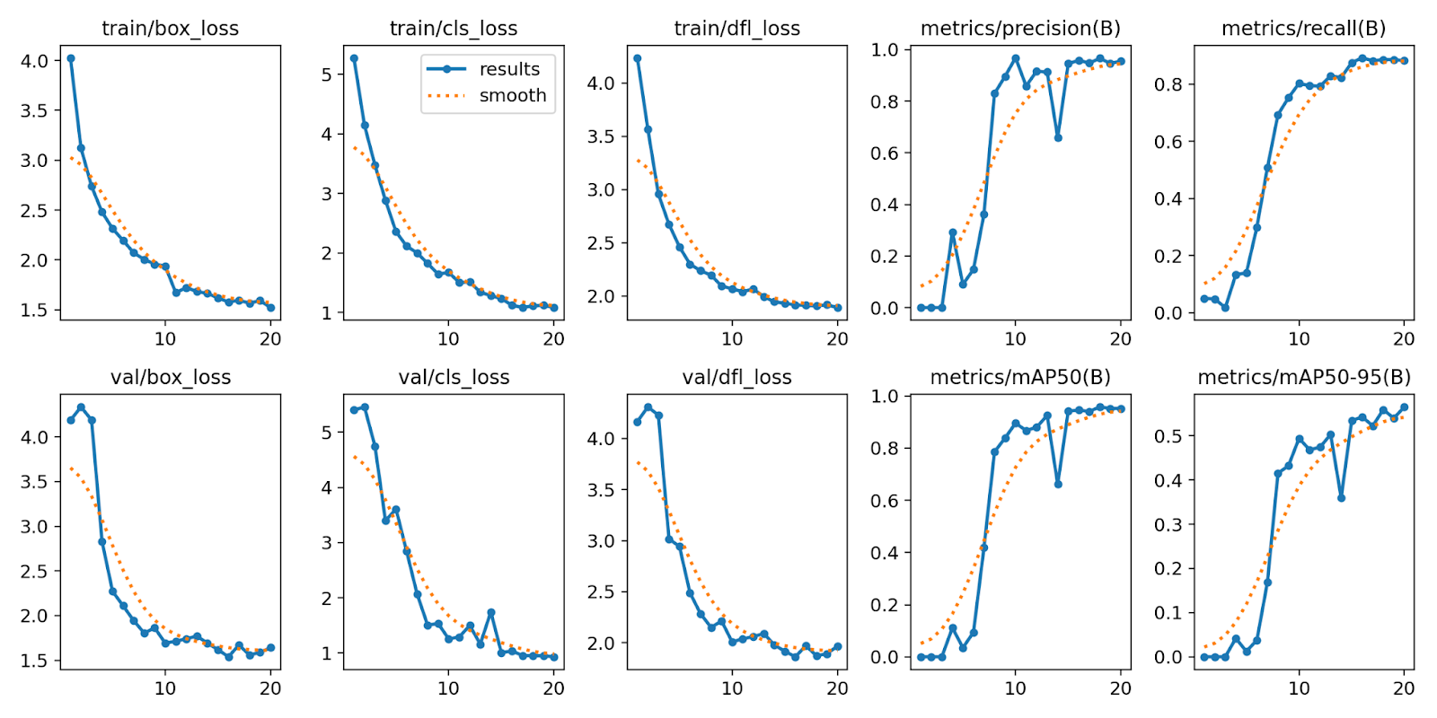
Evaluation
Figure 5: Batch Results

Slide 13
Conclusion
High Accuracy: The YOLOv8-based system achieved 97.8% accuracy in real-time Bengali vehicle number plate detection.
Practical Impact: The model improves traffic management and surveillance, performing well across diverse real-world conditions.
Future Enhancements: Further research will focus on improving adaptability to various number plate formats and challenging scenarios.

Slide 14
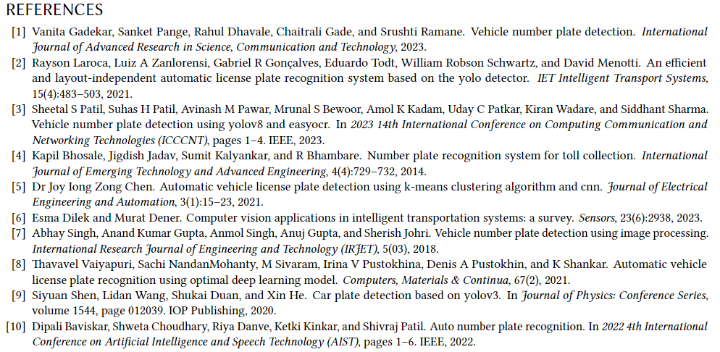
Reference

Slide 15

Any
Question?

